Slide 1
Presentation 6
Yaelle Pierre

Slide 2
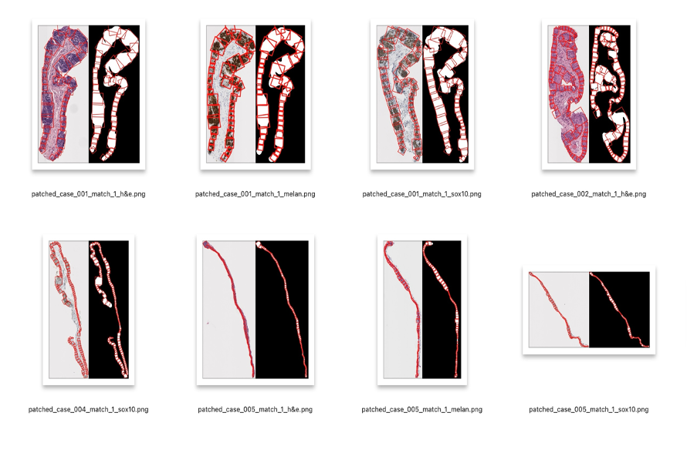
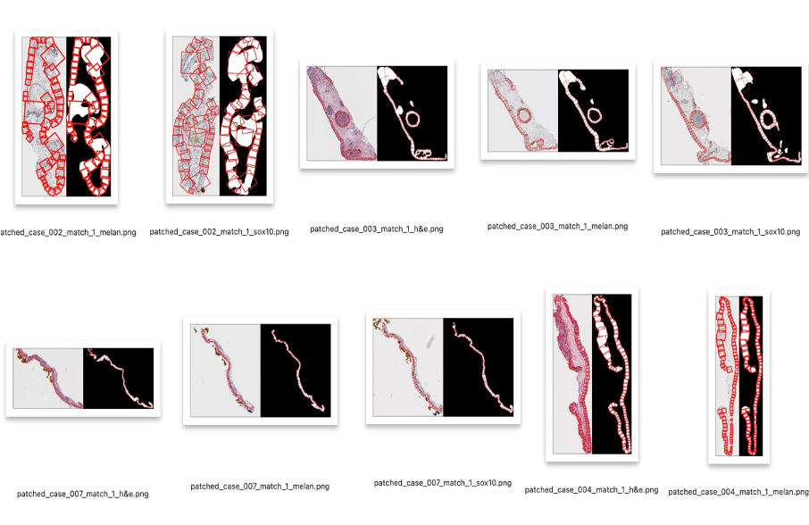
Patching Code Outputs

Slide 3
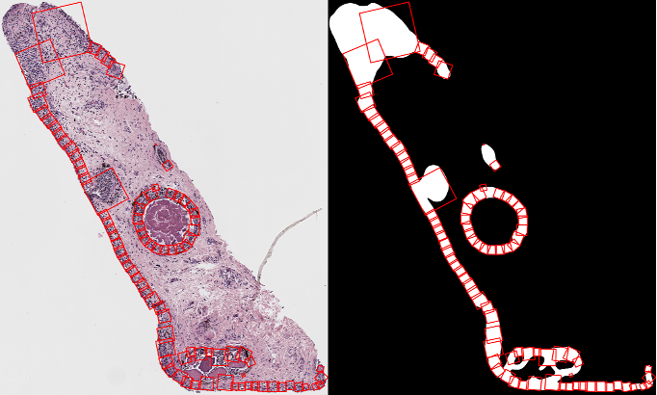
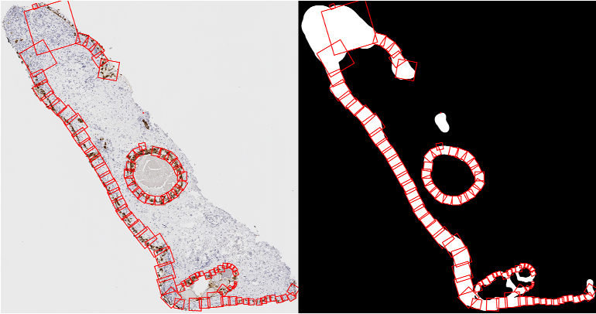
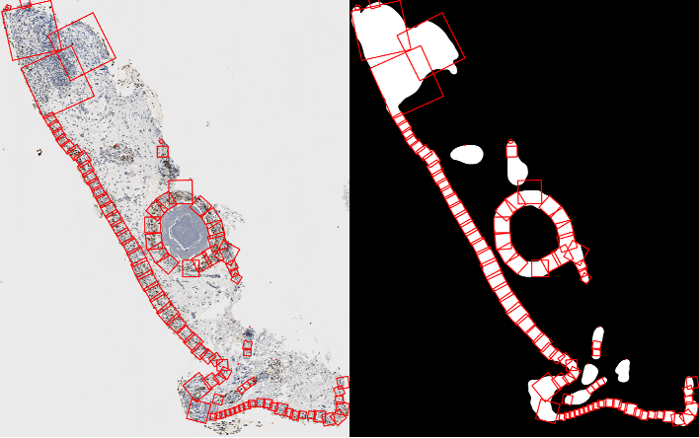
Case 003 h&e, melan, and sox10 outputs

Slide 4
Why isnt the patch capturing the epithelium width based on the mask on the small island in the middle ?

Slide 5
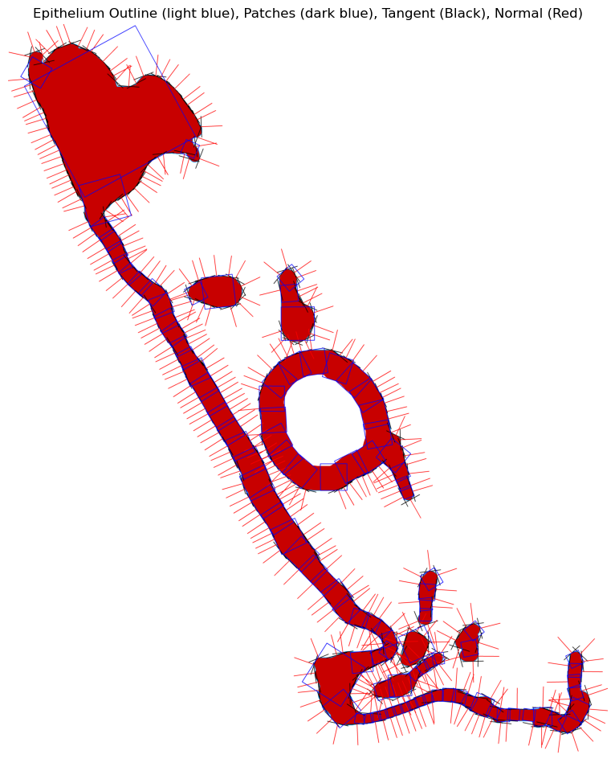
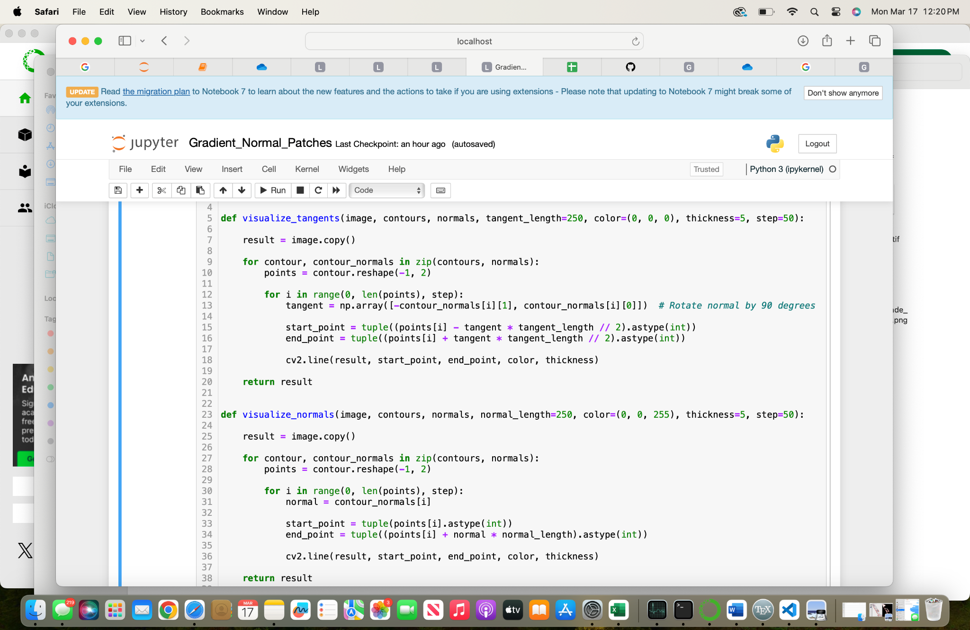
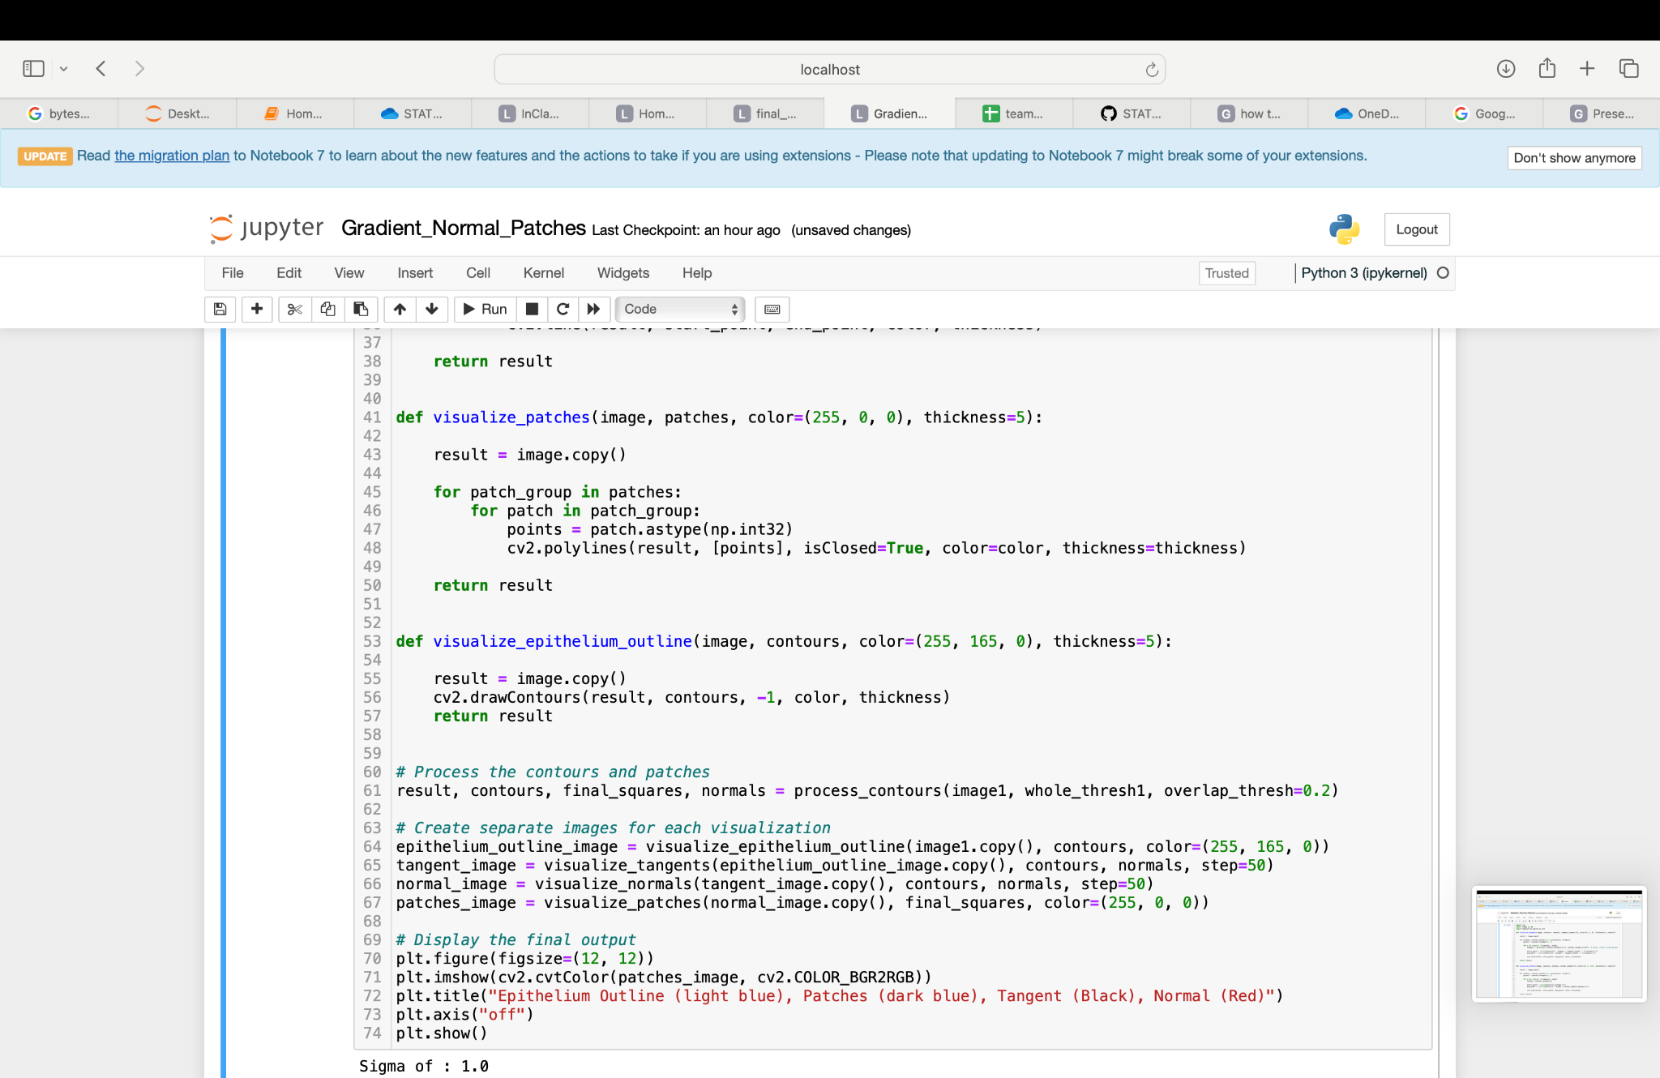
Visualizing tangents, normals, patches, and epithelium
I looked at Ryans code on how he visualized the tangents. From there I revised it so that it also visualized the normals, patches, and epithelium outline

Slide 6
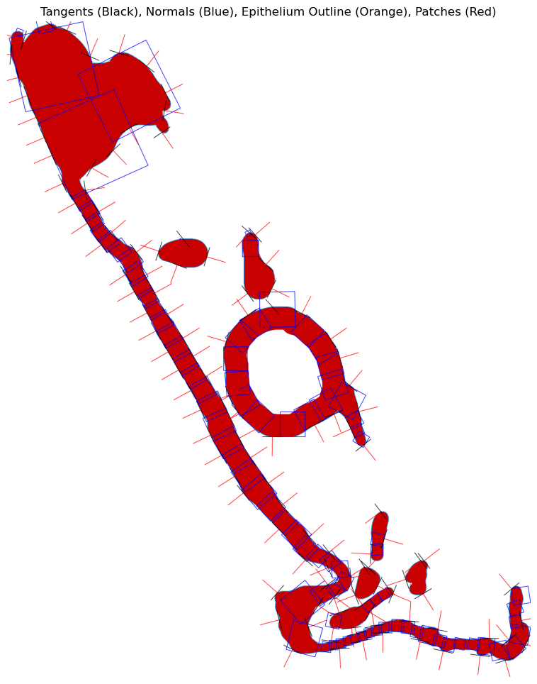
Visualizing the tangents, normals, and patches in final patching code
I modified the code to visualize the tangents, normals,and patches in the final patching code.
Instances in which there was a small dot happened when the normal was not perpendicular to the epithelium width

Slide 7
Final Patching Code vs Ryans Patching Code
Final patching code does not always create tangents that are on the width of the epithelium.
The small patch on the island is because of the misaligned tangent leading to a normal that is not perpendicular to the epithelium width
This is due to the differences in how the tangents/normals and the create smarter patches functions are constructed

Slide 8
Possible Causes
1: Patch overlap threshold might be filtering it out
If the patch overlaps too much with a previously placed patch (more than the overlap_thresh defined) it is being discarded
Reduce overlap_thresh or allow for at least one patch to form even if it overlaps
2:The normal calculation might be wrong
If the normal points slightly inward, it will reduce the detected width causing the epithelium to not be able to be registered from the background pixels causing the width calculations to be 0
Create a normal calculator that changes based on the normals being created

Slide 9

Incorporate create_smarter_patches from Ryans code into Final Patching Code

Slide 10
Thank You!

